Slide 1
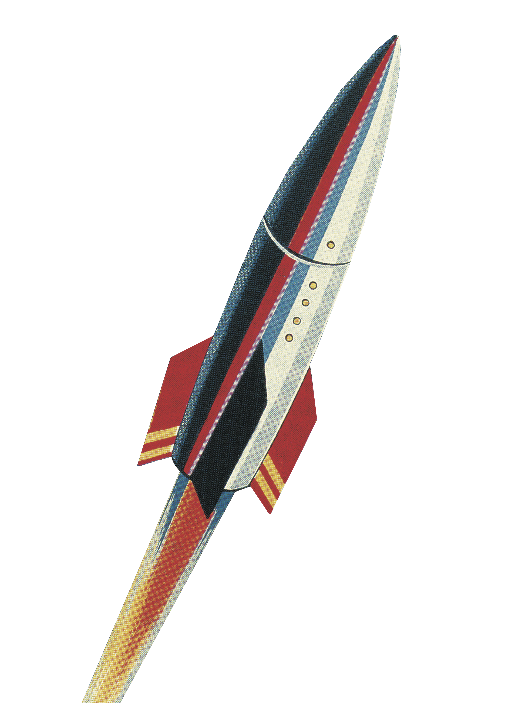
let your training journey begin

Slide 2
I’d like to learn about this product myself…

Slide 3
Using this presentation
Navigate to a specific section using the interactive links on the next slide, OR
Follow along slide-by slide
We recommend you view this PowerPoint in Presentation mode for the best experience.

Slide 4
Contents
Introduction to the product
What is it? What’s in it? Who is it for?
Getting started on the platform
The homepage, browsing and searching, and the results page
Exploring journal content
Journal portals and article pages
Creating an Account
Saving searches, saving favourite journals and managing alerts

Slide 5
Introduction to the product
Back to Contents
What is it? What’s in it? Who is it for?

Slide 6
SAGE Journals is a platform that hosts all of SAGE’s journals, giving you access to timely, high-quality, peer-reviewed research articles in your discipline.
SAGE publishes in many disciplines, from Communication, Education and Psychology through to Engineering, Medicine and Research Methods. You can browse all our journal titles at
http://journals.sagepub.com/action/showPublications

Slide 7
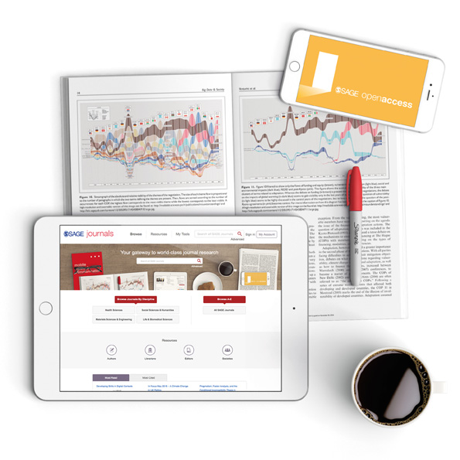
What’s in it?
The content you can access through SAGE Journals will depend on the subscription at your library
It’s possible your library does not subscribe to all of our journals
If you do not have access to a particular article, you will see the following icon next to the article:
If you aren’t sure which journals your institution subscribes to, please check with your library staff

Slide 8
Who is it for?
Students and researchers
Learn the key themes and debates on your topic
Keep track of the most recent developments in your subject area
Conduct literature reviews for your research projects
Find authoritative references for your assignments and research
Understand what makes a good-quality journal article
Faculty
Help students understand their study topics with evidence-based research
Link to articles and relevant journals in your Learning Management System
Stay up-to-date on the most recent developments in your field
Get an alternative view of impact with Altmetric data

Slide 9
Getting started on the platform
Back to Contents
The homepage, browsing and searching, and the results page

Slide 10
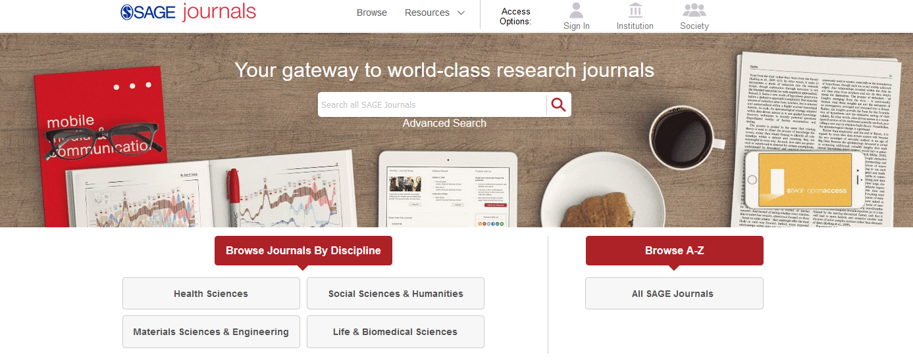
The SAGE Journals homepage https://journals.sagepub.com
SAGE articles will also be available through your library catalogue, and search engines like Google.

Slide 11
Using Browse options
You can browse our journals by discipline…
…or see all our journals in an alphabetical list.

Slide 12
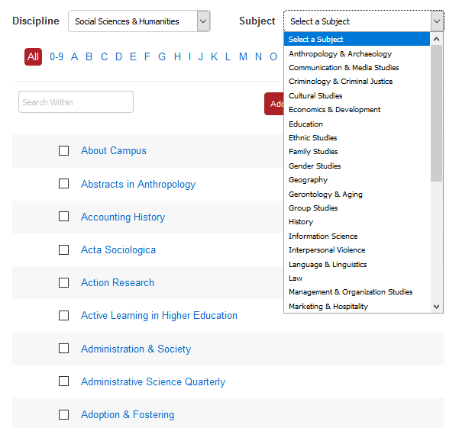
Using Browse options
Use the Browse drop-down menus to see what journals we publish in your subject area.
Click on a journal title to go to its homepage and start exploring the publication.

Slide 13
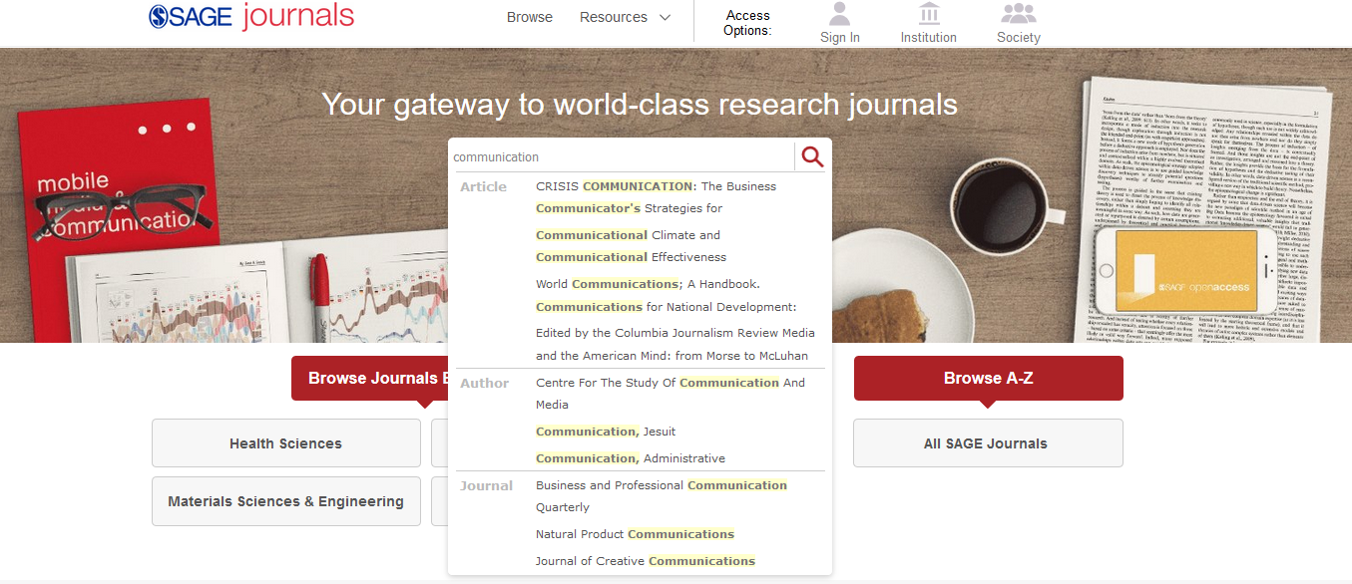
Using the Quick search
Use the quick search to look for key words and phrases; you can use Boolean Operators AND, OR and NOT.
Hit search or click on one of the auto-suggestions.

Slide 14
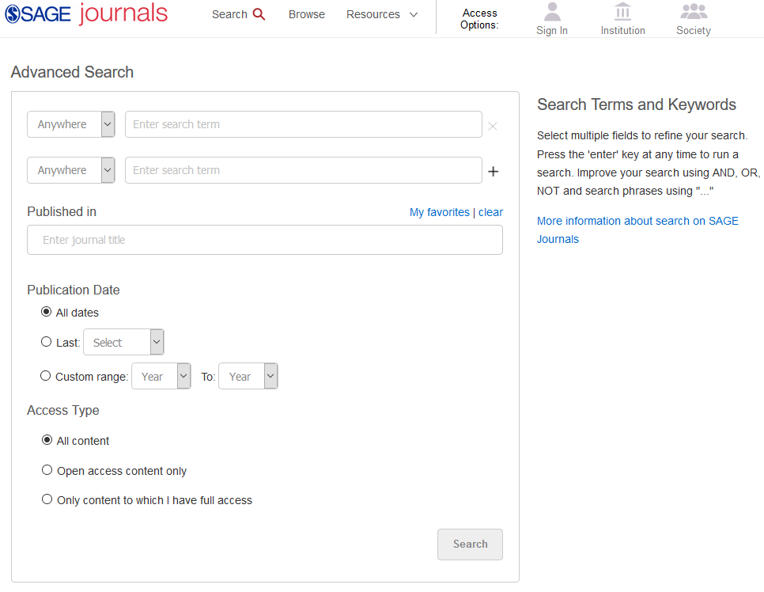
Using the Advanced search
Click the search bar from any page to run a quick or advanced search.
Enter your search criteria
Add new rows of search criteria
Customise your publication date
Choose which content you want to see in your results
Choose to search within particular journals only, and to search only across journals saved to My Favorite Journals

Slide 15
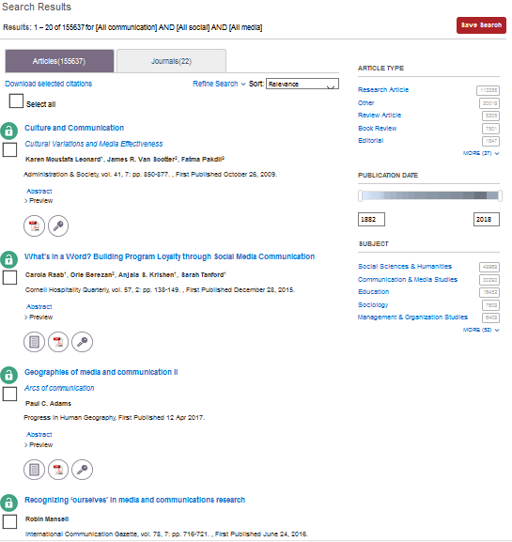
Viewing your results
Use the filters on the right-hand side of the search results page to refine your search.
Click the article title to view the article, or download the PDF straight away by clicking on the PDF icon.
The Publication Date slider ensures you are seeing the most recently-published results.
TIP: The darker the box, the more content available from that year; the lighter the box, the less content available from that year.
Article is available through your library’s subscription
Article is not available through your library’s subscription
Article is available because it is Open Access

Slide 16
Applying your learning
Visit the SAGE Journals homepage at https://journals.sagepub.com or find it via your library catalogue
Run a search based on a current assignment or project you are working on
Use the filters to find articles from 2018 only

Slide 17
Exploring journal content
Back to Contents
Journal portals and article pages

Slide 18
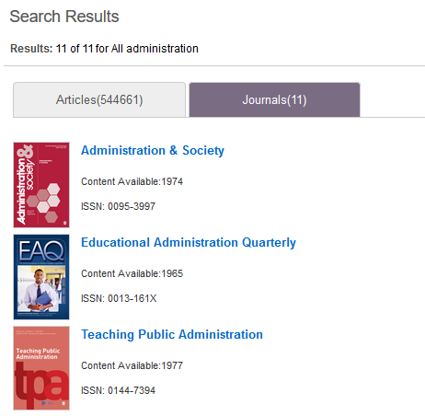
The journal portal
2) Run a search, select the Journals tab in the results page, then click on the journal title.
There are two ways of getting to a journal’s portal homepage:
1) Use the Browse page and click on the journal title.

Slide 19
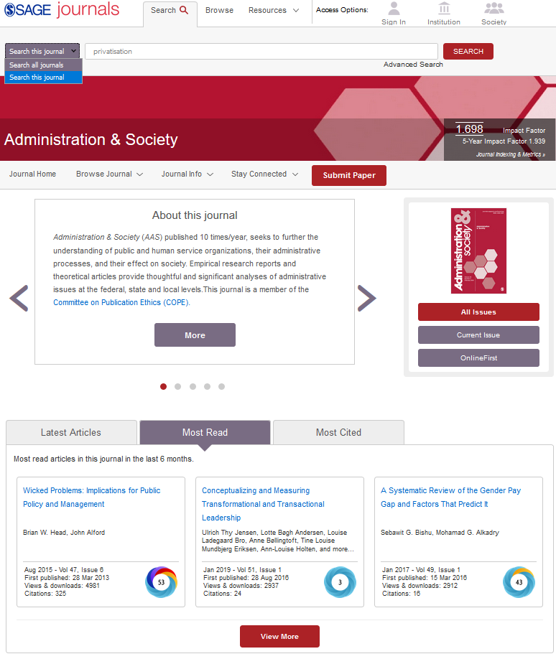
Search only within this journal
View Impact Factor and journal ranking information for the journal
Submit your own research to this journal
Browse current and all issues of this journal
Check OnlineFirst for early digital access to the most recent articles in this journal
View Latest Articles, Most Read and Most Cited articles from this journal
View Altmetric information for this journal article

Slide 20
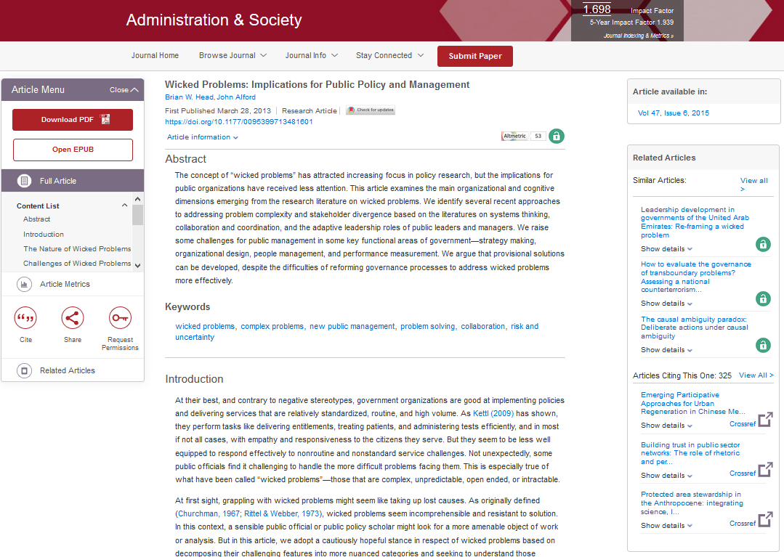
The article page
View author information
View Almetric data for this article
Download article PDF to read offline
View other articles that have cited the one you are reading
Easily move between article full text, supplemental material, figures and tables and article metrics
Run related keyword searches
View full-text of article
Download article citation information
Please note: some (older) articles are only available as PDFs and you will not see this webpage-view.
Share article link with a colleague or co-researcher

Slide 21
Applying your learning
Find a journal in your subject area using the Browse page
Run a search within your chosen journal
Open an article and download the PDF
Download the citation for your chosen article

Slide 22
Creating an Account
Back to Contents
Saving searches, saving favourite journals and managing alerts

Slide 23
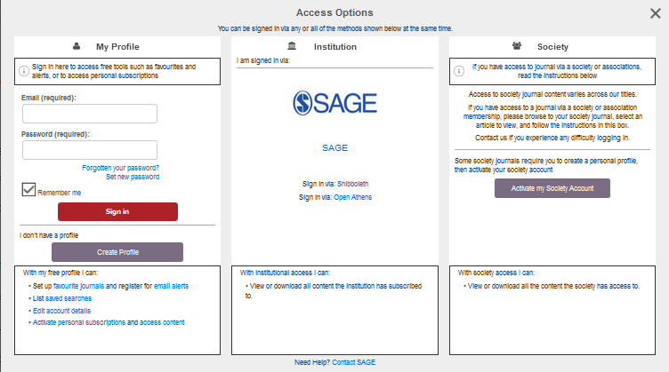
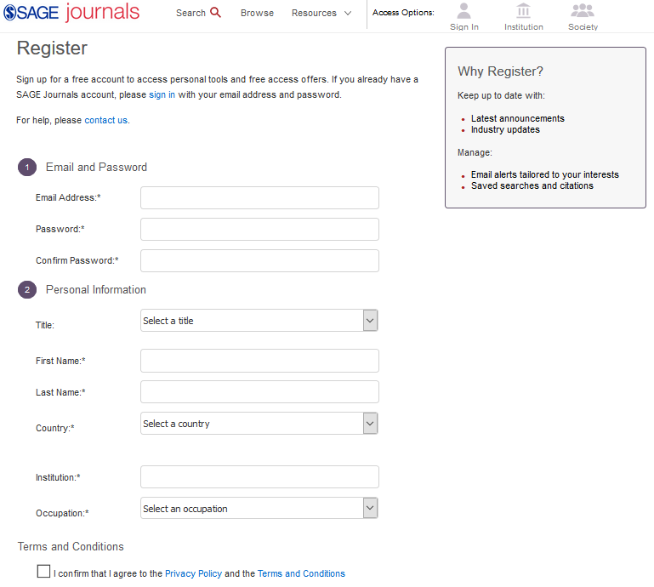
Creating an Account
Once you’ve clicked Create Profile, fill in your details in the registration form to set up your free Account, so that you can save searches, set up alerts and add journals to your favourites.
Click the Sign in button at the top-right of any screen, and then click on Create Profile in the pop-up window.

Slide 24
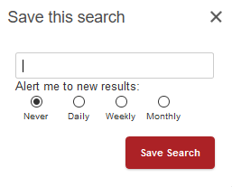
Saving searches
When you’re logged into your Account and you are viewing your search results, click the red Save Search button to save your search criteria, so that you can quickly re-run the same search again later.
You can also set up regular email alerts to be notified automatically when we publish new articles that match your search criteria.

Slide 25
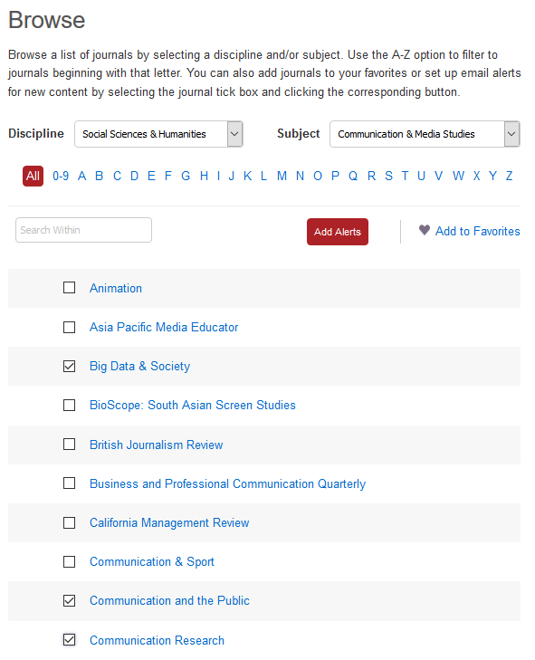
Saving favourite journals
When browsing our journals, select the tick-box of a journal you’re interested in, and click the Add to Favorites button.
Saving a journal to your favourites can be useful when you want to use the Advanced search, because you can choose from the journals you have saved.
You can favourite multiple journals at a time by selecting as many tick-boxes as you like.

Slide 26
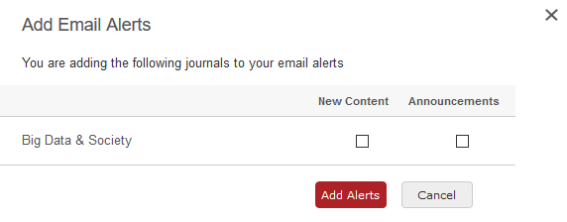
Setting up journal alerts
The first type of alert in SAGE Journals is the journal alert: this alerts you by email when new content is published in a specific journal.
From the Browse page, select the tick-box of the journal you want to receive email alerts for, then click the Add alerts button.
Confirm the alerts you want to receive, then click Add alerts. You can change the frequency of your alerts, and delete them, via My Account.

Slide 27
Setting up search alerts
The second type of alert in SAGE Journals is the saved search alert: this alerts you by email when new content is published matching your saved search criteria.
Run your search and add your search filters. When you click the red Save Search button, you will be given the option to choose how frequently you want to receive an alert.

Slide 28
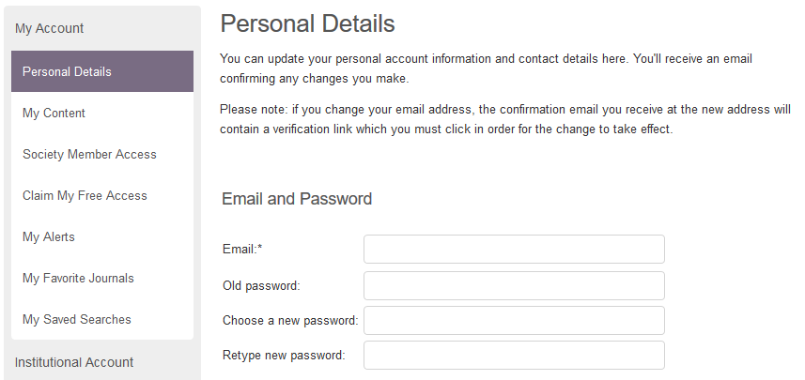
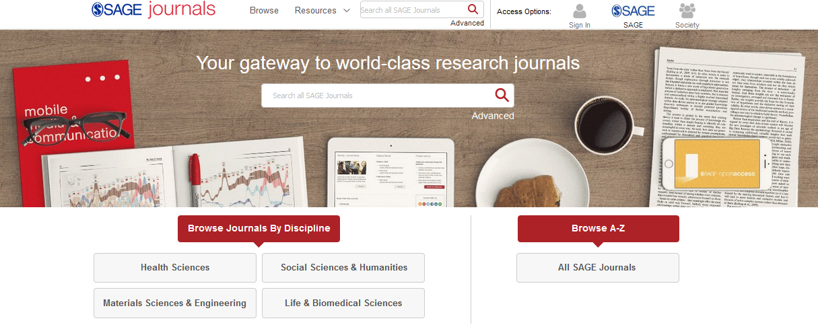
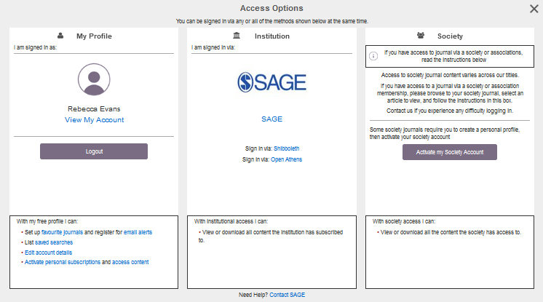
Managing your Account
From any page, click the Sign in button under Access Options. Once you are signed in, click View My Account in the pop-up window.
From any page, click the Sign in button under Access Options.
Use the menu options on the left to manage your alerts, your favourite journals and your saved searches.

Slide 29
Applying your learning
Create a free account on SAGE Journals from any page of the platform
Save a search based upon a current assignment or project
Save one journal to My Favorite Journals and add an alert for the journal
Change the alert frequency via My Account

Slide 30
Want to learn more?
Explore more of our training resources here.

Slide 31
Thank you for watching!
Back to Contents

